Slide 1


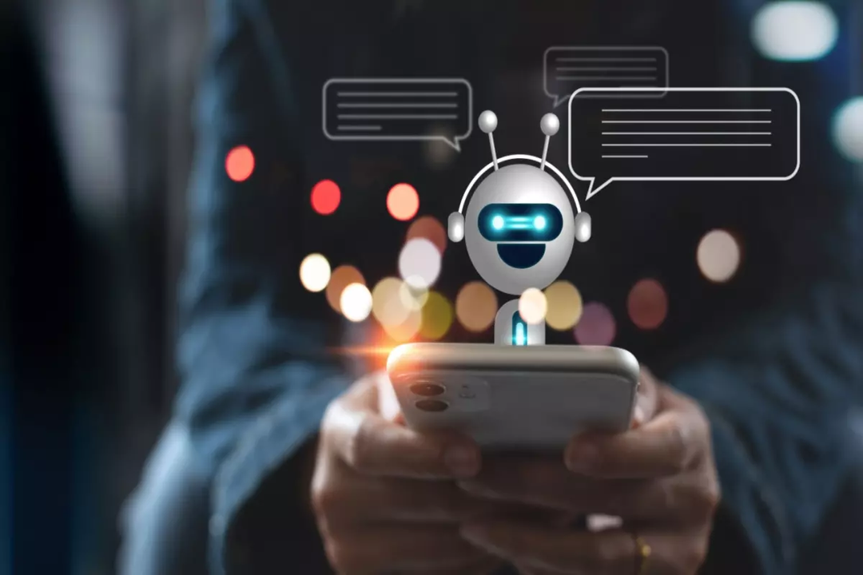
CAMERA CHATBOT

Slide 2
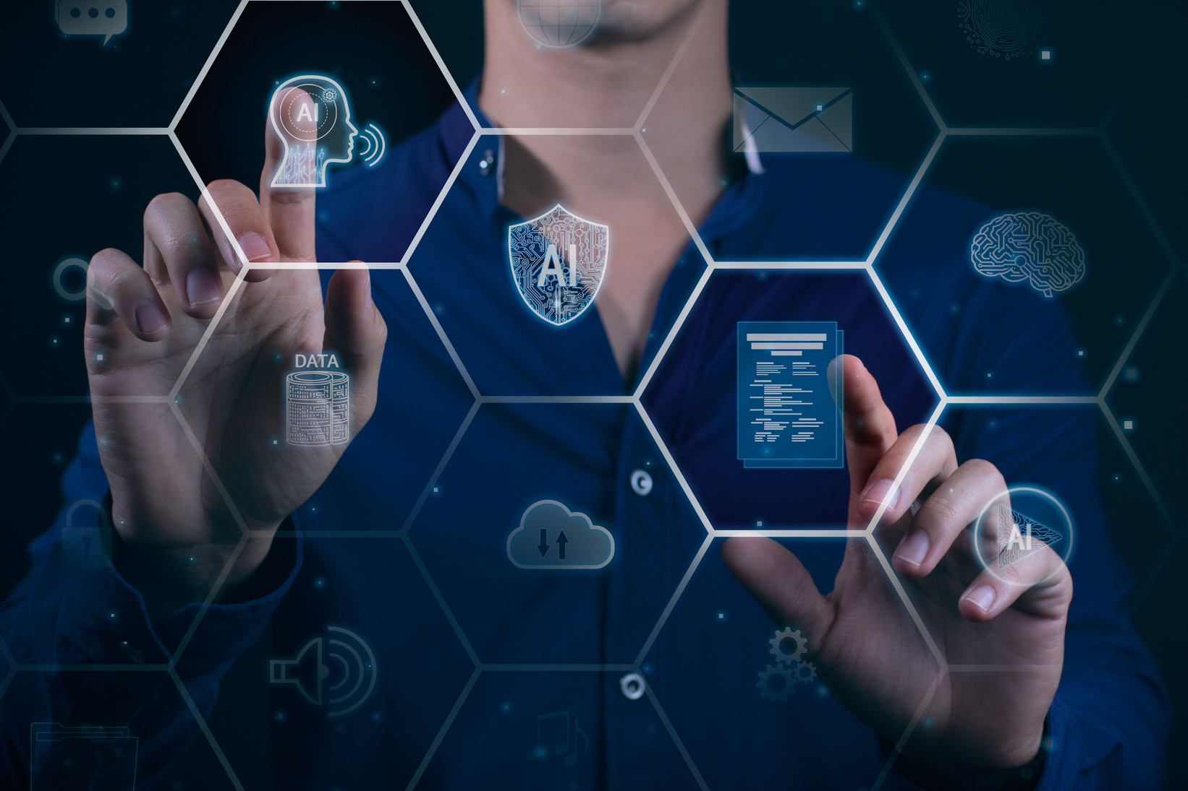
ABOUT THE PROJECT
The Smart Classroom Assistant is a desktop application designed to enhance classroom interactivity using AI technologies. It combines real-time object detection, speech-to-text conversion, and an AI-powered chatbot within an intuitive GUI.
Students or instructors can interact with the assistant using their voice, and the assistant will:
Recognize speech in real-time and display the transcribed text.
Respond using a large language model (e.g., Mistral via Ollama).
Detect physical objects or gestures in the classroom using a webcam and a deep learning-based detection model (YOLOv5).
This tool runs entirely on a local PC, making it suitable for educational settings where privacy and offline functionality are important.

Slide 3
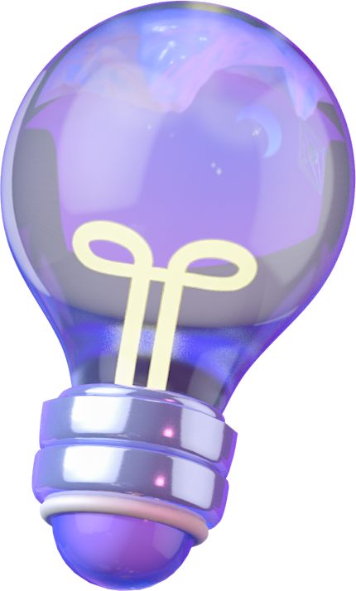
YOLOV5
YOLOv5 (You Only Look Once version 5) is a state-of-the-art, real-time object detection model developed by Ultralytics. It uses deep learning to detect multiple objects in an image or video frame in a single forward pass, making it extremely fast and efficient.
YOLOv5 is built on convolutional neural networks (CNNs) and is known for its balance of speed, accuracy, and small model size, making it suitable for real-time applications like surveillance, robotics, and classroom assistants.
It supports PyTorch, has pre-trained models (like yolov5s.pt, yolov5m.pt, etc.), and can be easily customized for detecting specific objects.

Slide 4
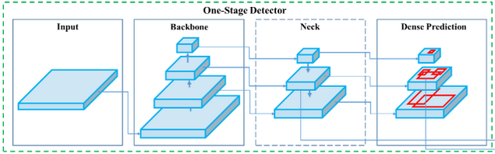
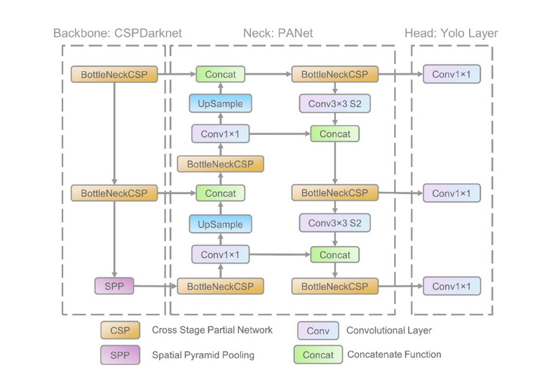
YOLOV5 Architecture

Slide 5

MISTRAL - OLAMA
Mistral is a lightweight, open-source large language model (LLM) developed to deliver fast and efficient performance while still generating high-quality text. It’s based on the Transformer architecture, the same powerful design used in models like GPT.
Mistral is trained on a large amount of internet text and is capable of:
Understanding and generating human-like responses
Answering questions
Summarizing content
Holding contextual conversations
In this project, Mistral is used via Ollama, which allows you to run the model locally on your PC—no cloud connection needed. This makes it perfect for private, offline AI chatbot interactions in classrooms.

Slide 6
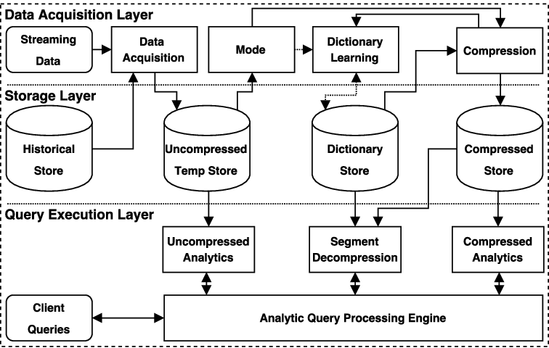

Slide 7
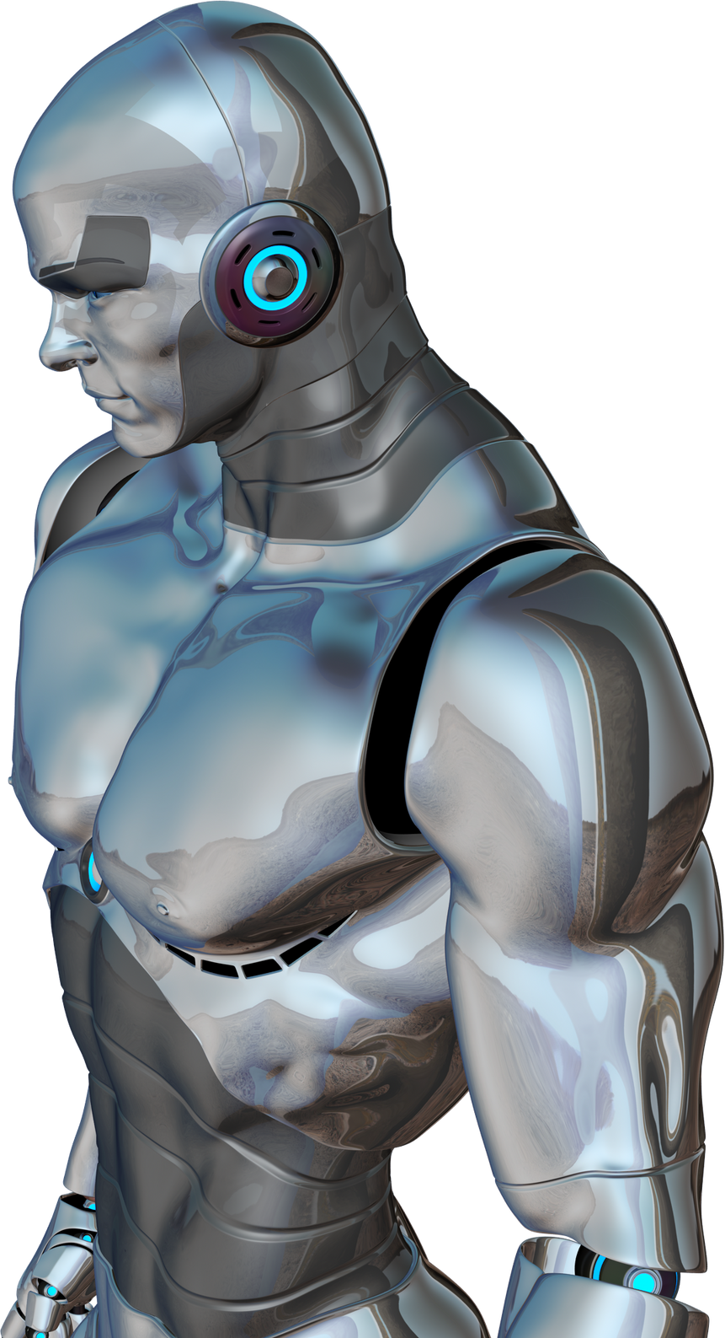
NATURAL LANGUAGE PROCESSING (CHATBOT WITH MISTRAL VIA OLLAMA)
Concept: A language model (LLM) that generates human-like responses.
Library/Tool: ollama, running Mistral model locally.
What it does: Converts user input (spoken) into a chatbot response.
DL Principle: Uses the transformer architecture, trained on large-scale text data to understand and generate meaningful text.

Slide 8

SPEECH-TO-TEXT (STT) CONVERSION
Concept: Converts spoken audio into text in real-time.
Library/Tool: speech_recognition + sounddevice
What it does: Captures live audio, converts it into text using Google's STT engine.
DL Principle: Google’s backend model uses recurrent or transformer-based deep learning models trained on audio-linguistic data.

Slide 9
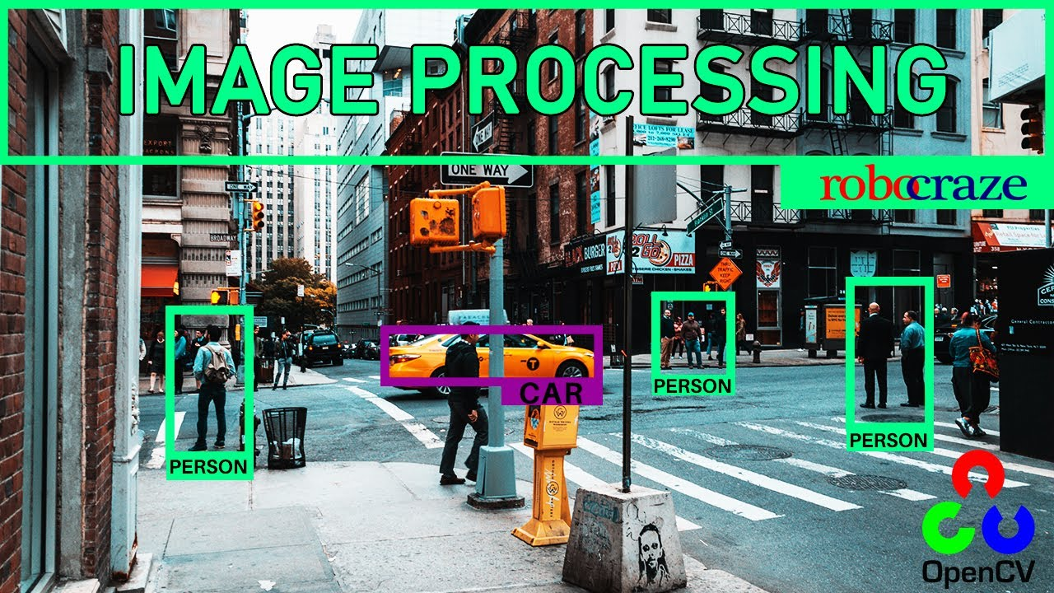
REAL-TIME VIDEO PROCESSING
oncept: Captures live webcam video and applies object detection.
Library/Tool: OpenCV, YOLOv5
What it does: Captures frames from the webcam, feeds them into YOLOv5, and overlays detection results in real-time

Slide 10
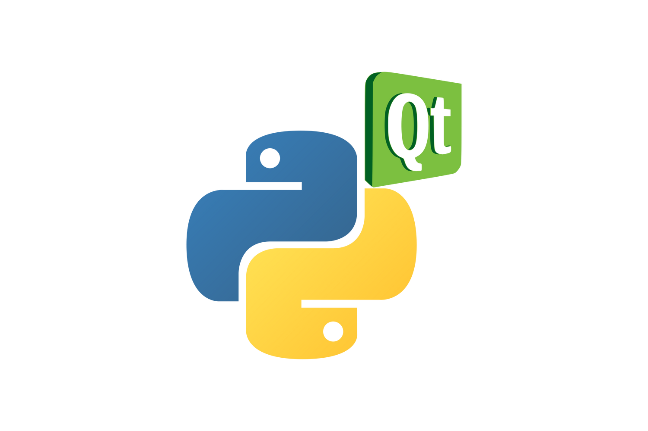
GUI DEVELOPMENT (USER INTERFACE)
Concept: Interactive desktop interface for controlling audio/video/chat.
Library/Tool: PyQt5
What it does:
Displays video frames with detection boxes
Shows transcription text
Provides chatbot interaction
Buttons for audio control

Slide 11
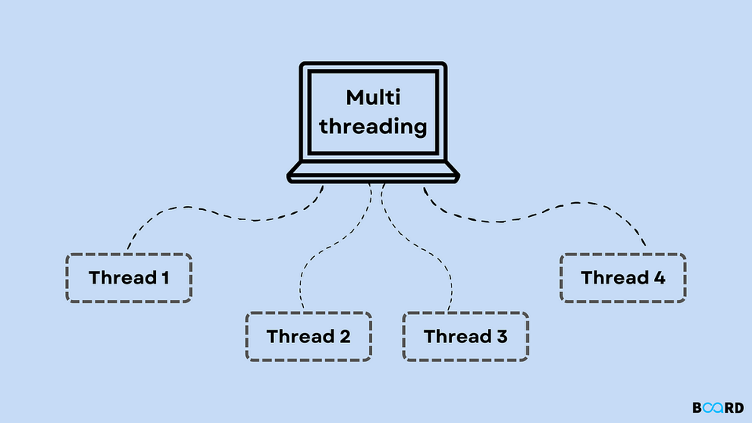
MULTI-THREADING FOR REAL-TIME PERFORMANCE
Concept: Running video and audio processing in parallel threads.
Tool: QThread from PyQt5
What it does:
Keeps the GUI responsive while processing audio/video in the background.
Avoids GUI freezing by isolating long-running tasks.

Slide 12
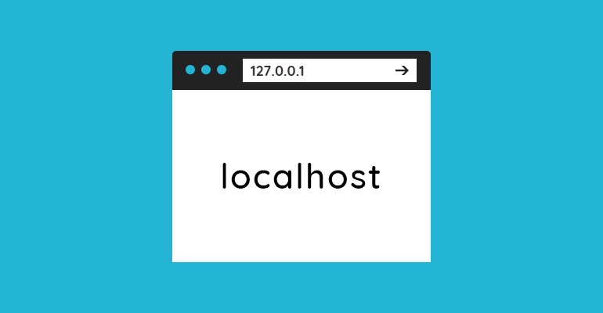
LOCAL EXECUTION & PRIVACY
Concept: No cloud services needed.
Tool: Ollama runs LLM locally using models like Mistral.
Why it's important: Ensures data privacy and works without internet access—great for offline classrooms.

Slide 13
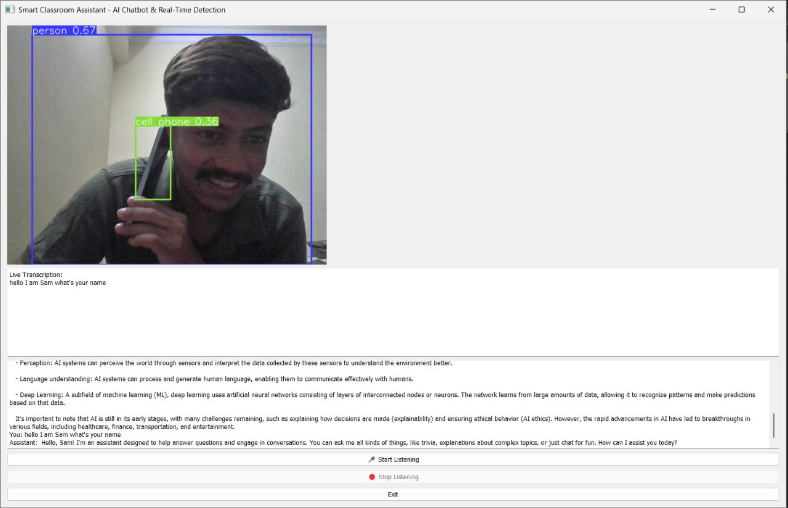

Slide 14
THANK YOU!
FOR YOUR ATTENTION

